Slide 1
Nuclear Fuel Performance
NE-533
Spring 2023

Slide 2
Last time
Covered hydriding in the cladding
Hydrogen is produced through corrosion and picked up by cladding, forming hydrides
Hydrides are brittle, and so reduce the ductility of the cladding
Preferentially form on the outer rim of the cladding due to stress state and solubility
Covered RIA type accidents
RIA is often caused in PWR/BWR by control rod ejection/drop
Shorter pulses have greater impact than longer pulses (given same energy deposition)
Effects of RIA depend on burnup includefission gas, FCMI, oxide layer, hydrides, cladding pressure, etc

Slide 3
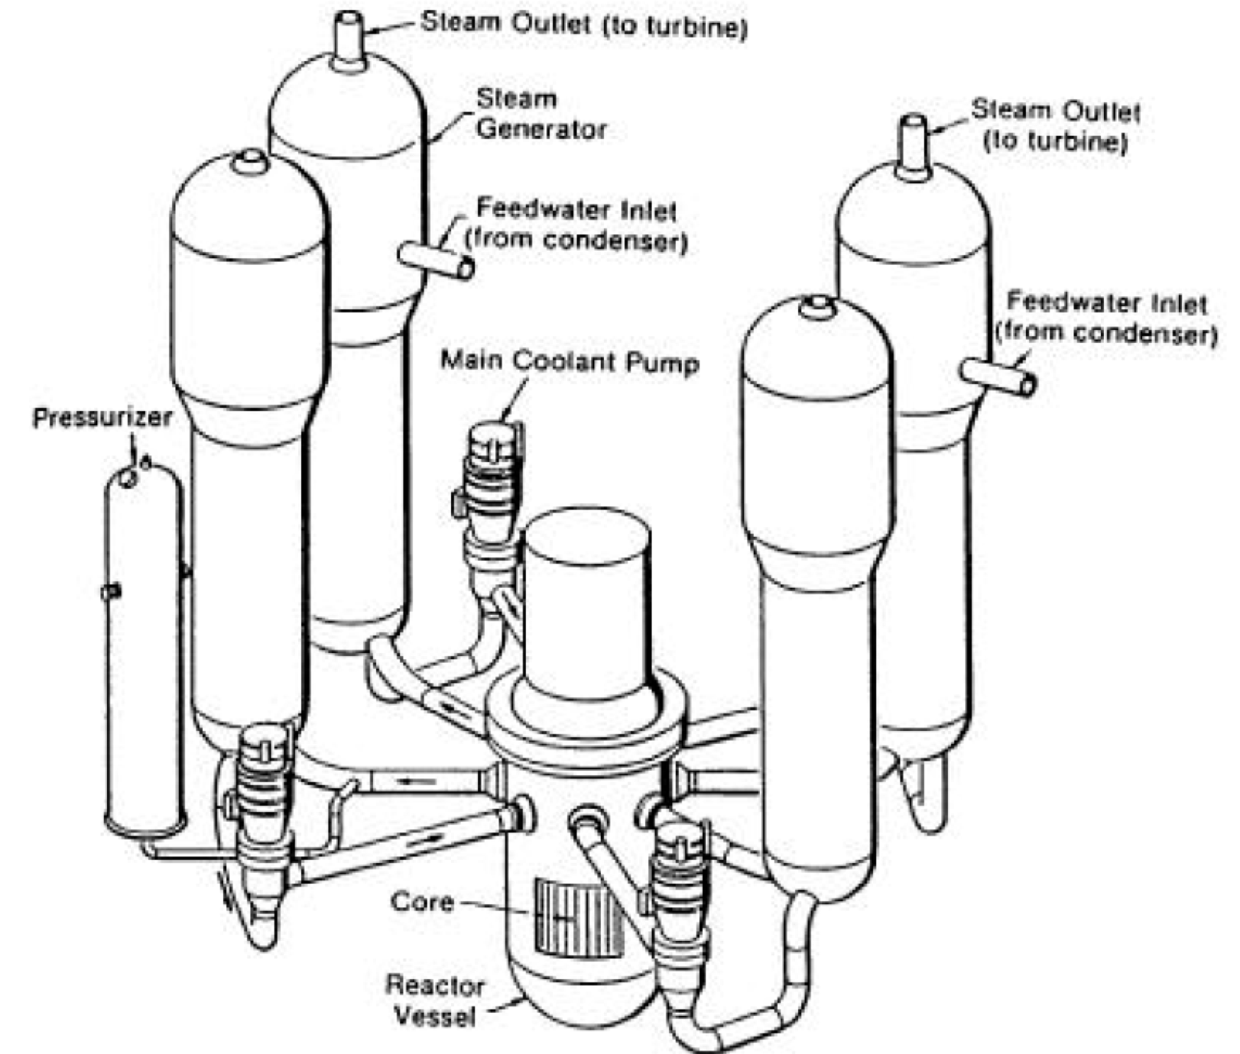
Loss of Coolant Accident (LOCA)
Design basis accident for LWRs
In a LOCA, the coolant flow is reduced or lost altogether (e.g., coolant pipe break)
When this occurs, pressure drops, engaging the emergency shutdown system
SCRAMS the reactor, stopping the fission chain reaction
Also, the reactor water is expelled into the containment
The emergency core cooling system (ECCS) begins to remove heat
Requirement to maintain a coolable geometry

Slide 4
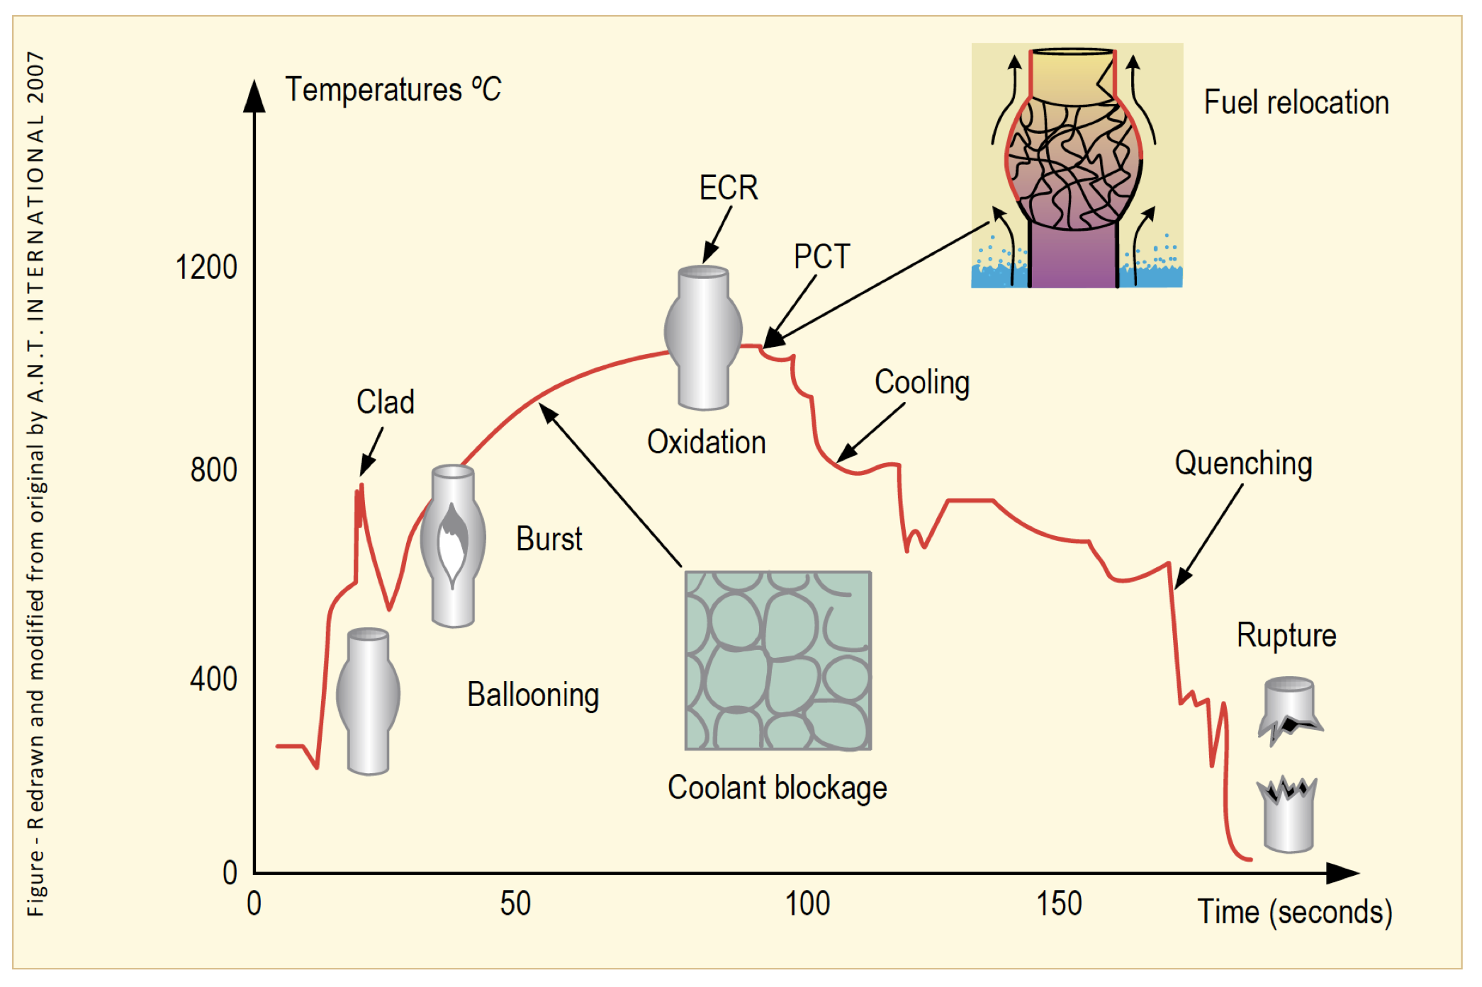
Loss of Coolant Accident (LOCA)
The average temperature of the reactor continues to rise due to radioactive decay in the fuel and the lower cooling
Decrease in coolant pressure and increase in internal pressure causes large plastic deformation
Causes the cladding to balloon out and potentially burst
Ballooning blocks coolant flow
Cladding burst is significantly impacted by oxidation and hydride embrittlement

Slide 5
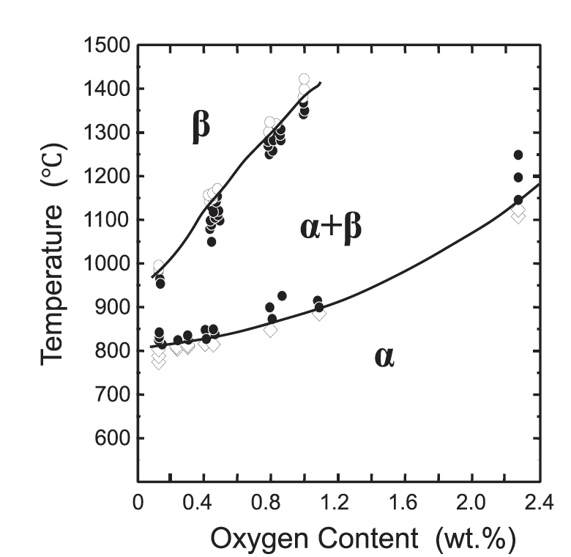
LOCA
During the heat-up, the cladding plastically deforms (balloon and rupture) due to decrease of the system pressure outside the fuel rod and decrease in cladding strength
The phase structure of Zircaloy transforms from alpha to alpha+beta above about 800C, and to beta above about 1000C
The cladding reacts with steam or coolant at high temperatures, and an oxide (ZrO2) layer is formed on the surface of the cladding
In addition, absorbed oxygen stabilizes the alpha-phase and a layer of alpha-phase with a high content of oxygen begins to grow on the beta-phase, and the beta-phase becomes less ductile by the oxygen absorption

Slide 6
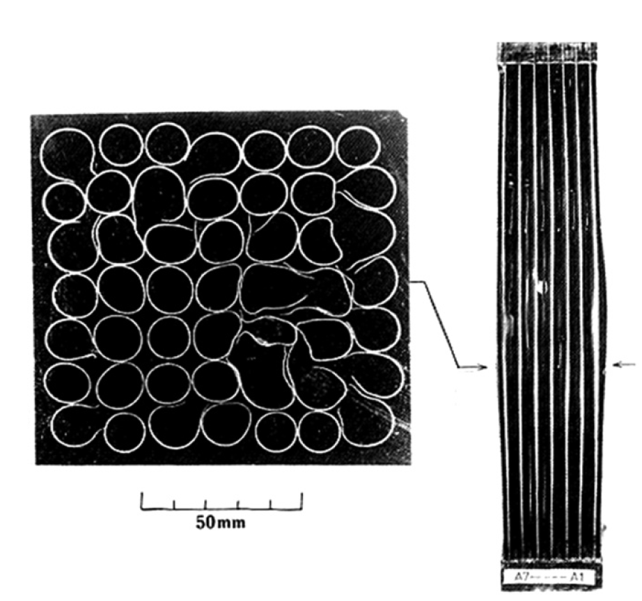
LOCA
The rod pressure becomes higher than the system pressure of the reactor due to a break of the coolant pressure boundary
Creep strength of Zircaloy rapidly falls with the temperature
The cladding plastically deforms in the radial direction during the heat-up and may rupture
The beta phase has different creep properties than the alpha phase, and alpha+beta phase can exhibit superplastic behavior
Large plastic deformation of the cladding in the radial direction results in blockage of the coolant channels between fuel rods

Slide 7
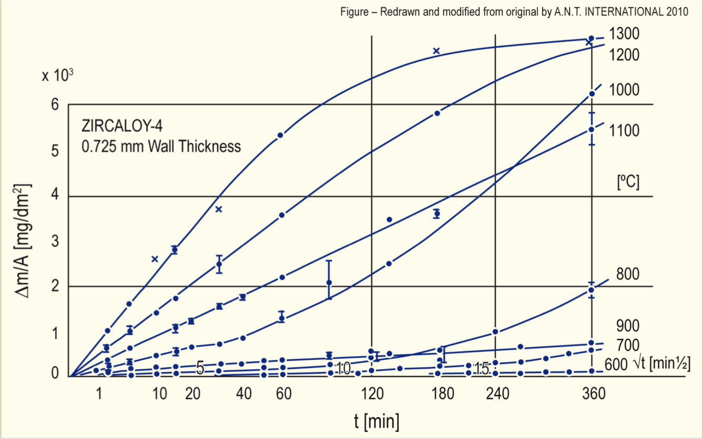
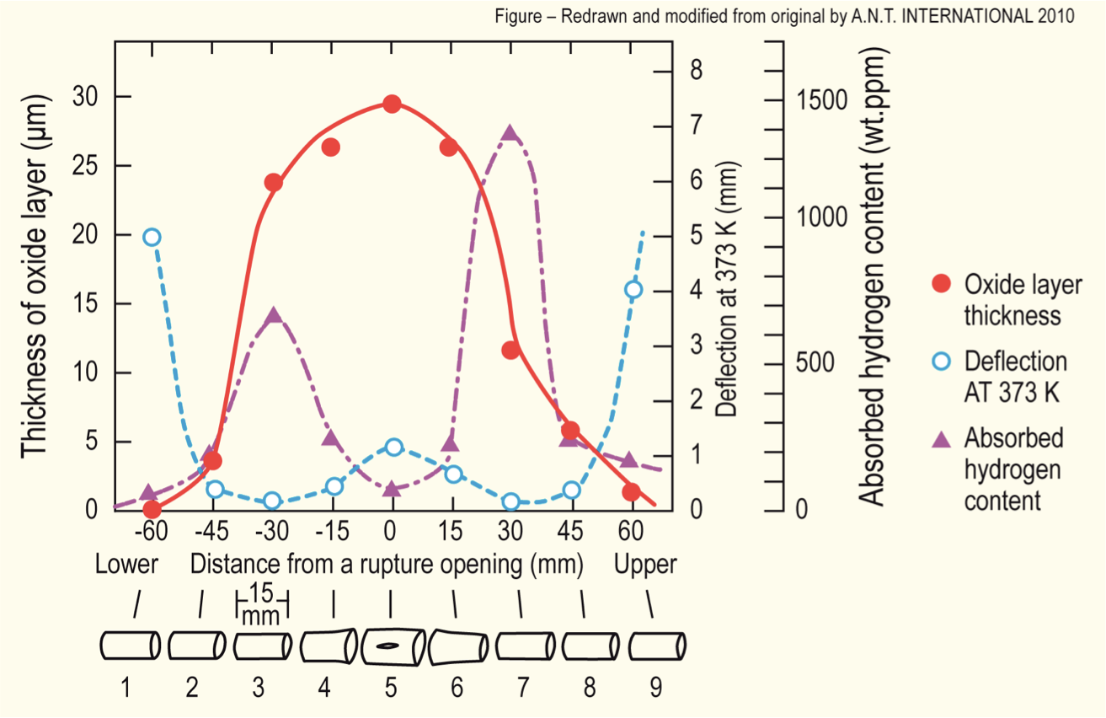
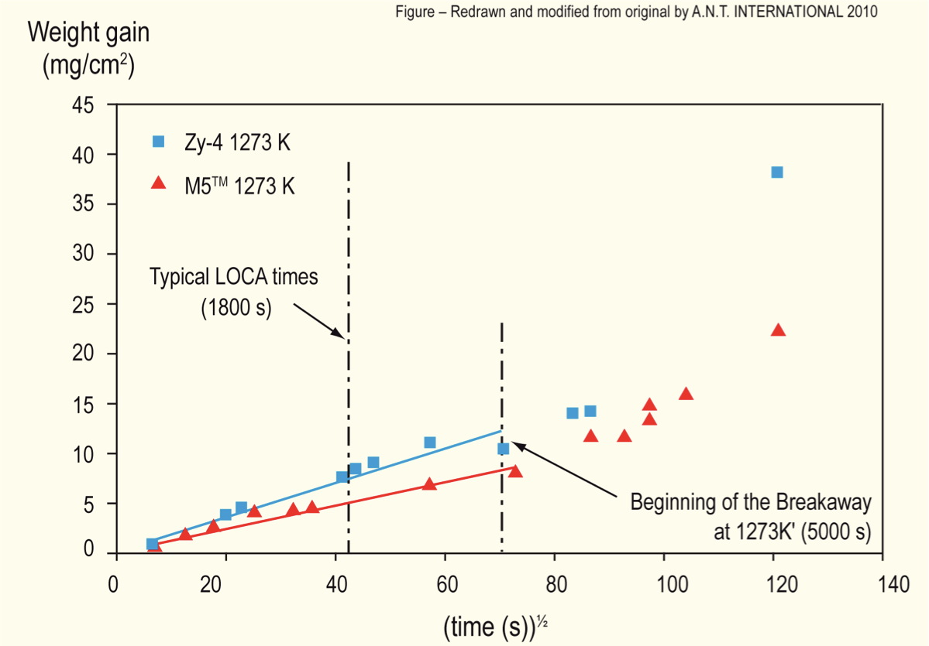
Oxidation
Oxidation significantly increases at high temperatures
Due to exothermic heat generated during oxidation of the cladding, at high enough temperatures, the rate of oxidation is so high that the heat can no longer be dissipated by cooling, leading to run-away oxidation (Three Mile Island)
Breakaway oxidation results in increased hydrogen pickup, embrittling the cladding
Excess H generation can lead to H2 gas accumulation inside the containment

Slide 8
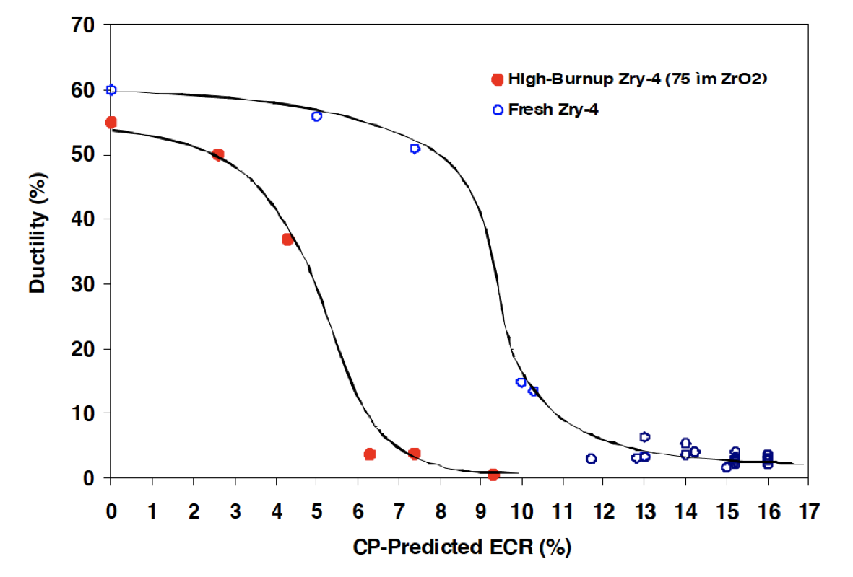
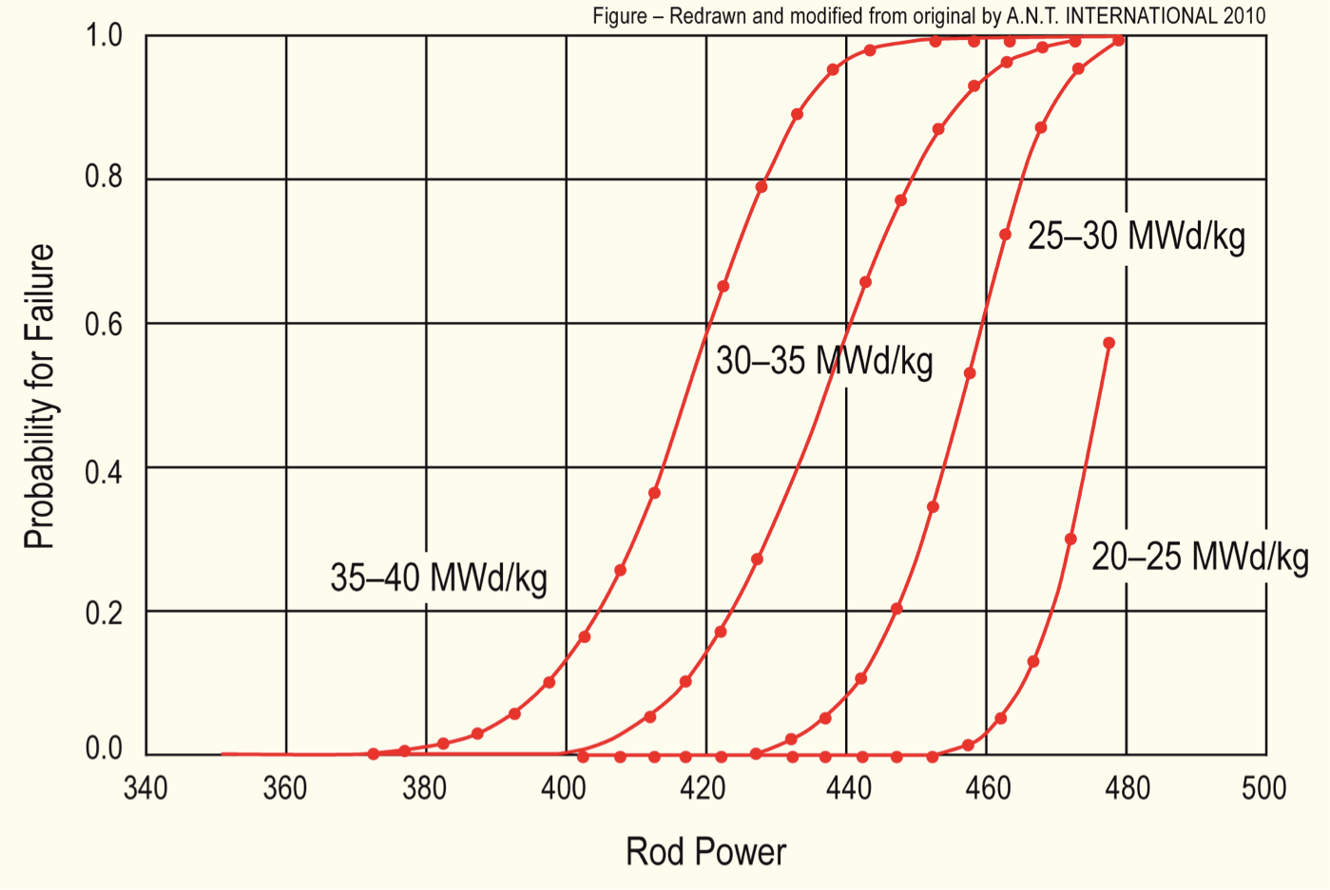
Effect of Burnup
At high burnup, ductility of the cladding is significantly reduced due to existing corrosion, hydrogen embrittlement, and irradiation hardening
This leads to higher likelihood of failure for higher burnup conditions
Alloys with lower corrosion could potentially go to higher burnup, and retain ductility under a LOCA
Similar to RIA (but more slow), temperature increases can lead to gas bubble pressure increases, fuel fragmentation, increased thermal expansion, FCMI, etc.

Slide 9
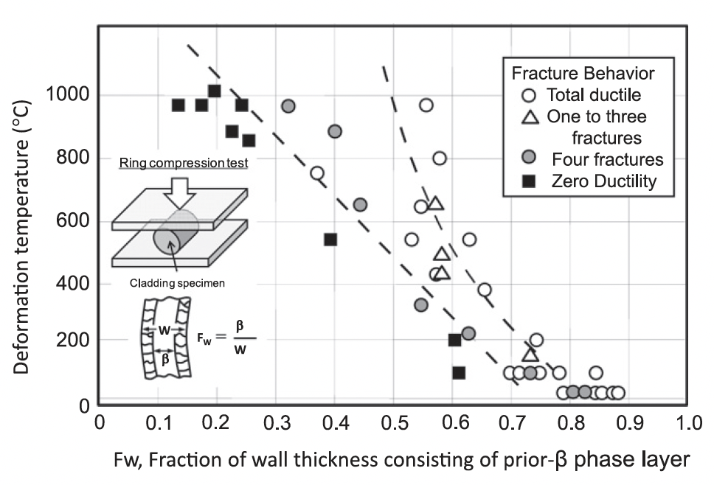
Embrittlement
On rewetting of the cladding by ECCS water, a thermal shock by quenching is induced
If the cladding is severely oxidized at temperatures above 1000C, the embrittled cladding may be fragmented by the quenching
The ductility decreases as the fraction of the unoxidized layer decreases
There are limits imposed on the amount of oxidation to limit brittle failure on ECCS quenching

Slide 10
Mitigation through design
Accident tolerant fuels aim to provide additional coping time
The time required for the water to boil away
The time required for the fuel to melt
The time required for the molten fuel to breach the primary pressure boundary
Fuels with enhanced tolerance can tolerate loss of active cooling for a considerably longer period, while maintaining or improving performance during normal operation
Can also widen the existing safety margin for nuclear plants and improve nuclear plant performance with fuel that lasts longer

Slide 11
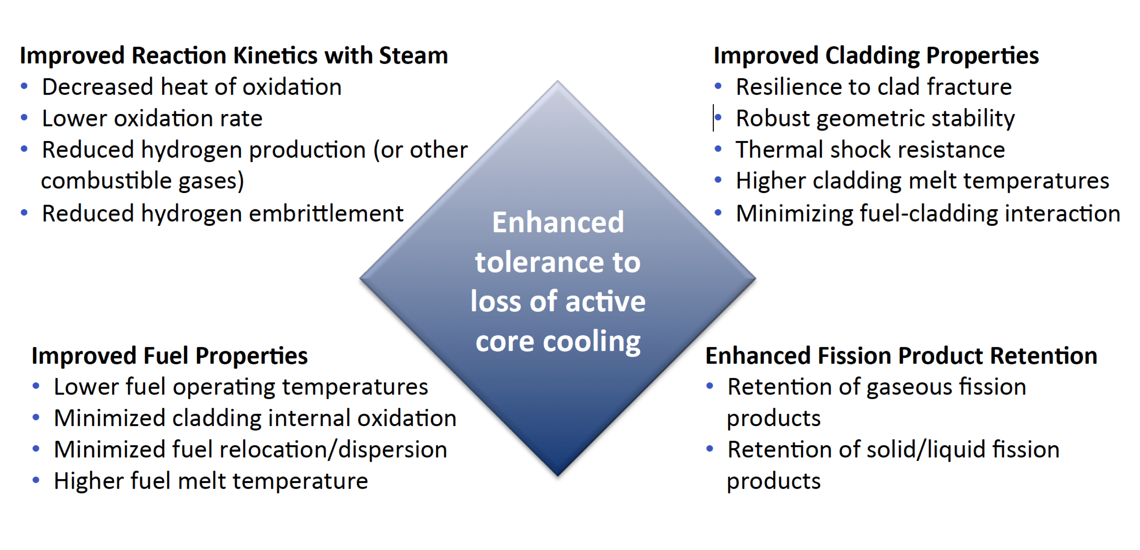
Accident Tolerance

Slide 12
Some ATF options being pursued
Cladding coatings/liners
protect the Zircaloy from steam: Ti3SiC2, Cr, etc.
Alternate claddings
SiC, FeCrAl, refractory alloys
UO2 dopants
Cr, SiC, BeO, etc.
Alternate fuels
USi, UN, UC, microencapsulated fuel

Slide 13
Summary
In loss of coolant accidents (LOCA), the fuel and cladding experience
increases temperature
decrease in coolant pressure
High temperatures lead to increased oxidation, producing additional hydrogen
This can lead to embrittlement, ballooning, and burst of the cladding
Fuel relocation and fission gas release in the fuel
Accident tolerant fuel includes different fuel and cladding materials to increase time before catastrophic behavior during an accident

Slide 14
Limiting phenomena

Slide 15
Limiting Phenomena
Concerning limiting phenomena, some criteria have been established for the UO2 and MOX fuel designs
Engineering must demonstrate that all relevant parameters fulfill those criteria at any time from the loading of the fuel to reprocessing, or during long-term storage
The key performance limiting phenomena are Pellet-clad mechanical interaction; Cladding elongation and assembly bow; Cladding oxidation and hydrogen pickup; Cladding wear; Power to melt; Fuel rod internal pressure; Departure from nucleate boiling; Normal operation limits

Slide 16
Limiting Phenomena
PCMI
PCMI is a complex process with a maximum risk for failure when the fuel pellet to cladding gap closes firmly and the reactivity of the fuel is still high
The risk is enhanced by pellet fragments inducing a local shear strain on the cladding, and by the chemical interaction kinetics at the interface
In order to prevent SCC, the cladding hoop stress calculated for normal operation and transients is limited
The extent of the total permanent hoop strain is limited during the whole lifetime of the fuel rods, typically to 1%

Slide 17
Limiting Phenomena
Cladding elongation and assembly bow
During irradiation, the anisotropic character of the cladding material and the preferential migration of vacancies and interstitials in specific lattice planes drive an overall cladding axial growth, activated by the fast neutron flux
When contact is established between the pellet and the cladding, pellet axial elongation causes an additional axial cladding strain
This can lead to fuel rod bow with pitch reduction between the rods, reducing thermal margins
Differential elongation of guide tubes in a PWR assembly can lead to an overall assembly bow

Slide 18
Limiting Phenomena
Cladding oxidation and hydrogen pickup
For the ZrO2 formation at the cladding waterside surface, a typical criterion is related to the ASTM criterion of a maximum cladding wall thickness reduction of 10%, which corresponds to an oxide thickness of the order of 100 microns
When the hydrogen concentration in the cladding exceeds the solubility limit, 70–100 ppm by weight at operating temperatures, zirconium hydrides will form
The impact of hydrides on key mechanical properties depends strongly on hydride distribution and orientation
Oxidation and hydrogen pickup are increasingly important at higher exposures, as the dependence on burnup is nonlinear

Slide 19
Limiting Phenomena
Cladding wear
The criterion for cladding wear at the contact points between grid spring/dimples and the fuel rod is often also related to the ASTM criterion of a maximum cladding wall thickness reduction of 10%
More wear is technically acceptable, as evidenced from operational experience

Slide 20
Limiting Phenomena
Power to melt
The use of uranium dioxide or MOX provides a comfortable power to melt margin
The melting temperature decreases slightly with burnup, but remains above 2750C
At high burnup, above 50 MWd/kgM, considering the fuel thermal conductivity decrease, the power to melt was estimated to be around 600 W/cm, which is an unrealistic high LHR

Slide 21
Limiting Phenomena
Fuel rod internal pressure
Significant reopening of the radial gap between the fuel stack and the cladding must be avoided to ensure the heat transfer to the coolant
If a gap opens, fuel overheating and excessive fission gas release can occur, ultimately leading to fuel failure
The original criterion required that the rod inner pressure must never exceed the outer coolant pressure
This criterion was over-conservative and has been replaced by a ‘nonlift-off’ criterion, where the radial creep-out of the cladding (driven by gas pressure in excess of the system pressure) must never exceed the expansion rate of the pellet
Experiments have shown that a large overpressure of the gas (considerably more than 5.0 MPa) is needed to initiate the reopening

Slide 22
Limiting Phenomena
Departure from nucleate boiling
With increasing heat flux there comes a point at which the heat transfer from a fuel rod rapidly decreases due to the insulating effect of a steam blanket that forms on the rod surface, resulting in a severe increase of cladding temperature and possibly cladding failure
The ratio of the heat flux needed to cause departure from nucleate boiling (DNB) at given local coolant properties (pressure, enthalpy, mass flow rate) to the actual local heat flux of a fuel rod is defined as the DNBR
This phenomenon may limit the maximum allowed thermal power of a given PWR

Slide 23
Limiting Phenomena
Normal operation limits
Constraints on the axial LHR distribution are typically applied at the core design level and during normal operation to guarantee that the conditions are never worse than those assumed in scenarios considered in the accident analyses
The maximum allowed LHR may depend on the axial position and on burnup, and can be reactor- and even cycle-specific
The fulfilment of the constraint is verified during the reload safety evaluation process as well as during plant operation

Slide 24
Summary
There are a variety of limiting phenomena in LWR fuel systems that provide the boundaries of operation and lifetime
These limits include phenomena in the fuel, gap, cladding, corrosion, and assembly levels
The performance of uranium dioxide and MOX fuels in LWR nuclear reactors is well established
These fuels have demonstrated a very good behavior during irradiation, favored by their high melting temperature, providing large operating temperature margins

Slide 25
water chemistry

Slide 26
Water Chemistry
Excellent water quality is essential if material degradation is to be controlled
Primary system water chemistry affects fuel performance through the deposition of corrosion products on fuel pin surfaces
In the early days of nuclear power plant operation, impurities in the coolant water were a major factor in causing excessive corrosion
Chlorides and sulfates are particularly aggressive in increasing intergranular stress corrosion cracking (IGSCC) and other corrosion processes
Initial efforts to improve water quality brought about a slow but steady reduction in impurities through improved design and operation of purification systems

Slide 27
Water Chemistry
Excellent water chemistry alone is not sufficient to control corrosion, thus programs to modify water chemistry, including minimizing oxygen to reduce the electrochemical corrosion potential (ECP) in BWRs, and oxygen and pH control in PWRs, have been implemented
Additives to further inhibit the corrosion process have been developed and are now in widespread use
Water chemistry advances are now an important part of the overall operating strategy to control material degradation

Slide 28
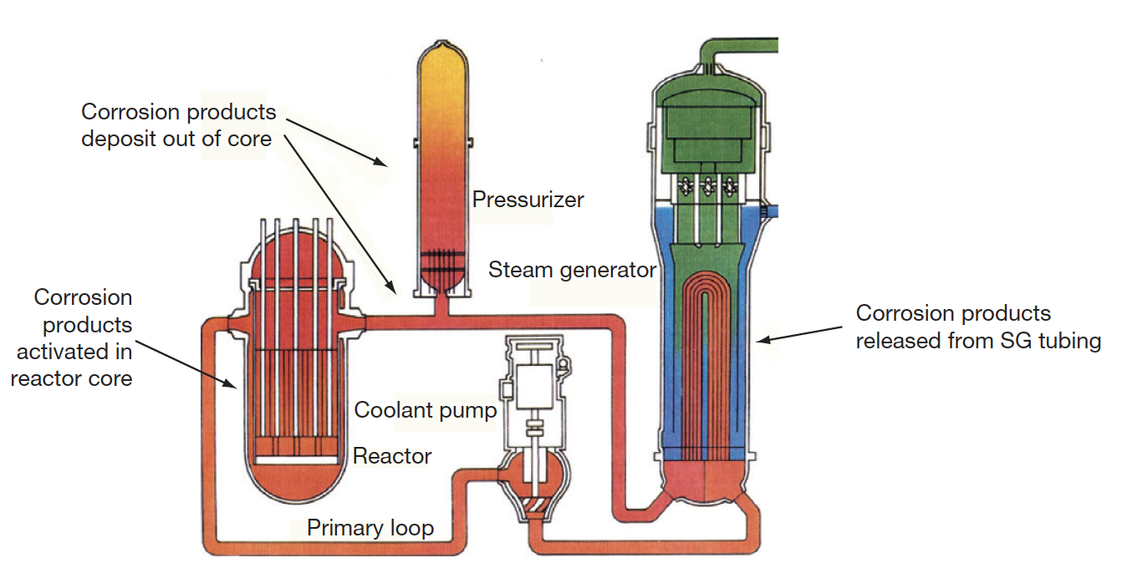
PWR Water Chemistry
In the very early days of PWR operation, heavy crud buildup on fuel cladding surfaces was caused by the transport of corrosion products from the steam generators into the reactor core
Activated corrosion products caused high-radiation fields on out-of-core surfaces fuel performance was compromised, and even coolant flow issues were observed

Slide 29
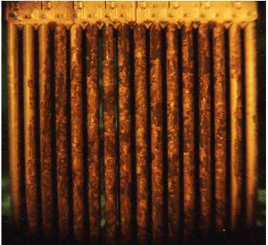
CRUD
A corrosion product called Chalk River unidentified deposit (CRUD) accumulates on the Ni alloy and stainless-steel surfaces
CRUD is an accumulation of materials and corrosion products that is composed of either dissolved ions or solid particles such as Ni, Fe, and Co on fuel rod cladding surfaces in NPPs
CRUD degrades heat production by nuclear fuel because it is slowly eroded by the circulation of the hot pressurized water and later deposited on the cladding or outer housing of fuel rods
The chemical composition of CRUD varies depending on the types of refueling cycles and the constituents of the basic metal material
Irradiation can produce radionuclides in the CRUD, such as 60Co and 63Ni

Slide 30
PWR Water Chemistry
PWR problems were initially mitigated by imposing a hydrogen overpressure on the primary system, reducing the corrosion potential, and raising the primary chemistry pH
Commercial PWR power plants use a steadily decreasing concentration of boric acid as a chemical shim (for reactor control) throughout the fuel cycle, which results in the use of lithium hydroxide to control pH
The concept of ‘coordinated boron and lithium’ was developed, whereby the concentration of LiOH was gradually reduced in line with the boric acid reduction to maintain a constant pH
It was determined that heavy fuel crud buildup was avoided if a constant pH of at least 6.9 was maintained
Zinc injection is utilized to reduce radiation fields, and also inhibits SCC

Slide 31
Radiation Control
Corrosion products deposited on the fuel become activated, are released back into the coolant, and may be deposited on out-of-core surfaces
During shutdowns, the major radiation source for personnel exposure is activated corrosion products, deposited on primary system surfaces
The mechanism of the zinc ion effect is complex, as release of ⁶⁰Co from fuel crud is reduced, and deposition out-core is also reduced
Aqueous zinc ion promotes the formation of a more protective spinel-structured corrosion film on stainless steel, especially when reducing conditions are present
Both cobalt and zinc favor tetrahedral sites in the spinel structure, but the site preference energy favors zinc incorporation
The ⁶⁰Co remains longer in the water and is eventually removed by the cleanup system

Slide 32
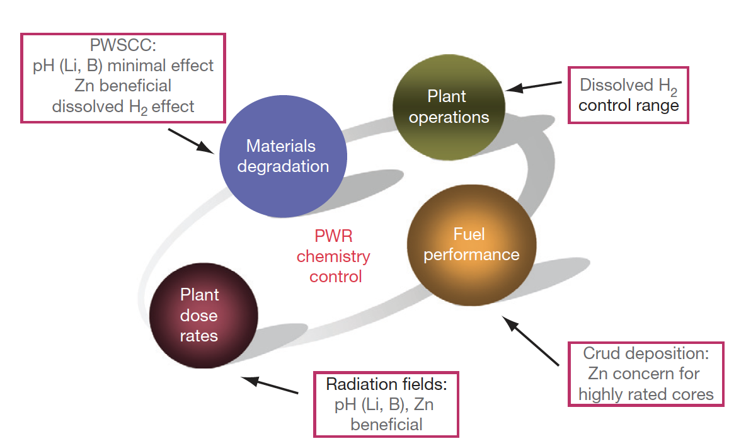
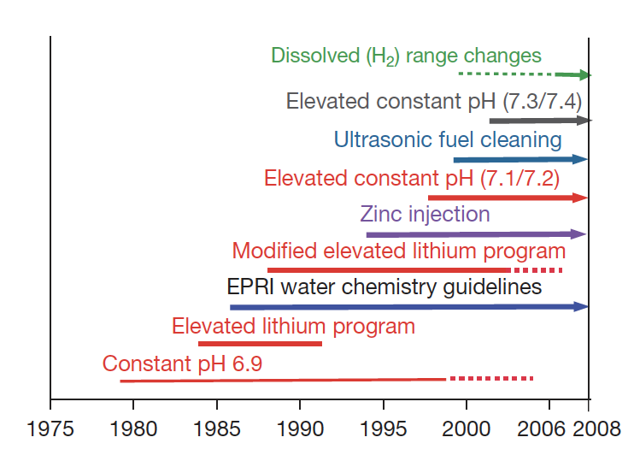
PWR Water Chemistry

Slide 33
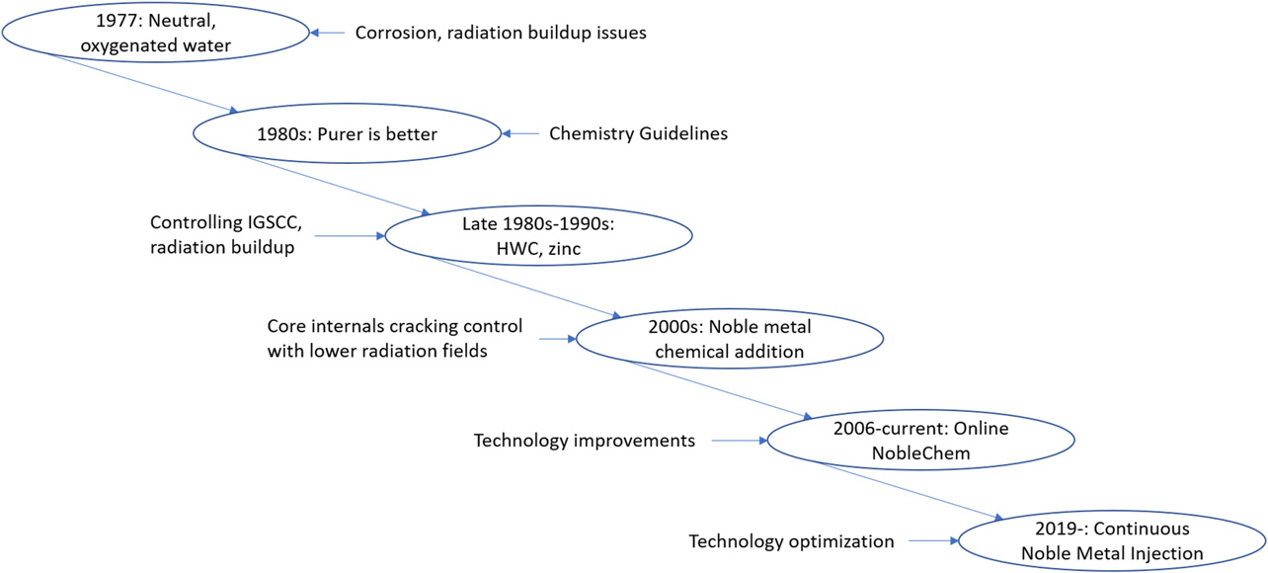
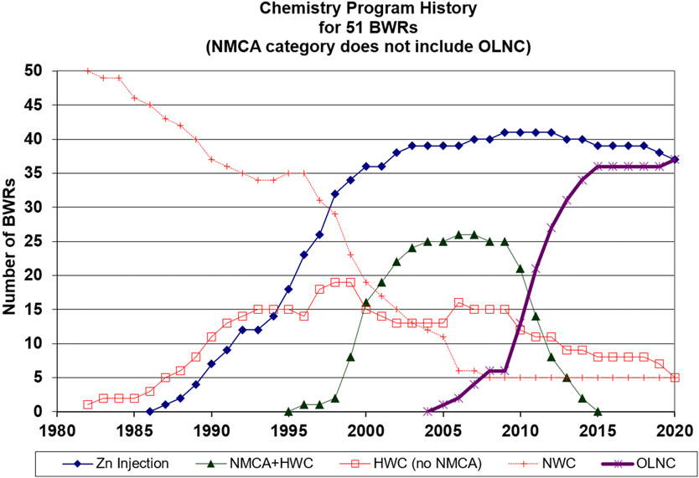
BWR Water Chemistry
Similarly, BWR water chemistry has to be optimized to meet requirements on material degradation, fuel performance, and control of radiation fields
BWR chemistry strategies have changed over time, focusing on purity, limiting SCC, and control of radiation fields

Slide 34
IGSCC Mitigation
Intergranular SCC (IGSCC) of 304 stainless steel core internals (and other materials) is one of the key chemistry control issues in BWRs
The control of the electrochemical potential (Redox potential) by hydrogen injection was effective at reducing IGSCC
Move from normal water chemistry (NWC) to hydrogen water chemistry (HWC) limits crack growth
Added noble metals (such as Pt) as coating on surfaces, or injection into water to increase efficiency of HWC

Slide 35
Summary
Brief overview of water chemistry concerns
Primary system water chemistry affects fuel performance through the deposition of corrosion products on fuel pin surfaces
Control measures such as dissolved H2 and balancing LiOH to boron content are utilized to control the pH
Zinc injection is utilized to control radiation fields

